Slide 1
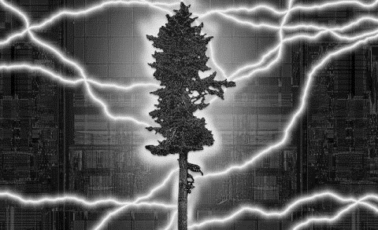

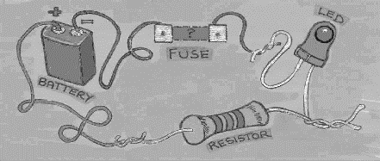
EHB222E QUESTIONS
4th week

Slide 2
A p-n diode is modeled with the exponential model. The diode currents are measured 1.36 mA and 7.20 mA when 0.7 V and 0.75 V applied, respectively. Determine the saturation current I_{S} and the emission factor n (from nV_{T}). Suppose that V_{T} = 25 mV.

Slide 3
Find the values of I and V for the circuits shown. Use ideal diode model (V_{d}=0) for diodes.
Ans. (a) 5 mA, 0V; (b) 0 mA, 5V; (c) 5 mA, 0V;
(d) 0.5 mA, 0V;

Slide 4
Use a modified ideal model for the Zener diode in Figure 1. The model has 0,7 V forward bias and 2V Zener (V_{Z}=2V) voltage. An input signal, shown in Figure 2, is applied. Sketch V_{o}, i_{D1} and i_{D2} in time domain. Justify your answer.
4.7V
0.7V
2V
-2V

Slide 5
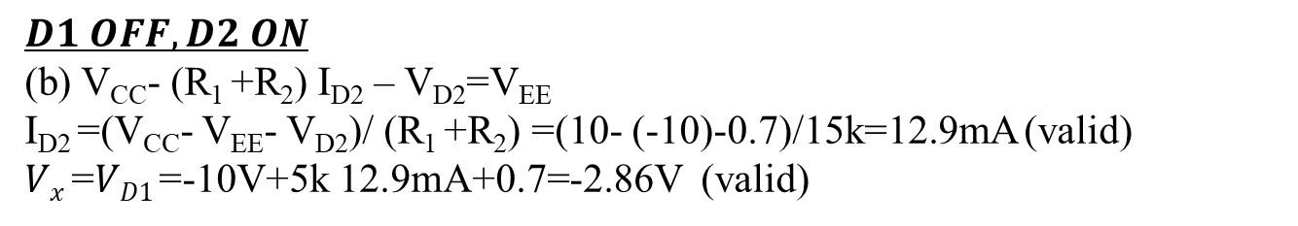

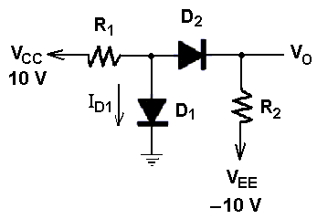
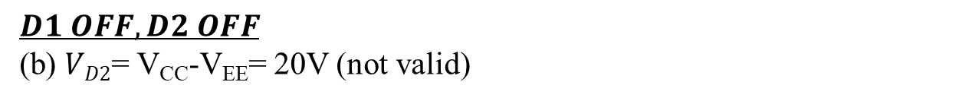
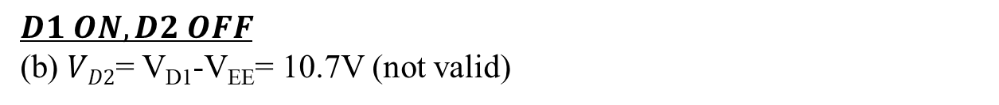
In figure, assume modified diode model (V_{D}=0.7V) for the diodes.
a) Calculate I_{D1} and V_{O} for R₁=5 kΩ, R₂=10 kΩ.
b) Calculate I_{D1} and V_{O} for R₁=10 kΩ, R₂=5 kΩ.
$$Vx$$
$D1 ON, D2 OFF$
(b) $VD2$= V_{D1}-V_{EE}= 10.7V (not valid)
$D1 OFF, D2 OFF$
(b) $VD2$= V_{CC}-V_{EE}= 20V (not valid)
$D1 OFF, D2 ON$
(b) V_{CC}- (R₁ +R₂) I_{D2} – V_{D2}=V_{EE}
I_{D2} =(V_{CC}- V_{EE}- V_{D2})/ (R₁ +R₂) =(10- (-10)-0.7)/15k=12.9mA (valid)
$Vx \text{=}VD1$=-10V+5k 12.9mA+0.7=-2.86V (valid)

Slide 6
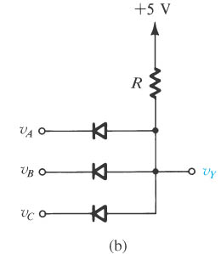
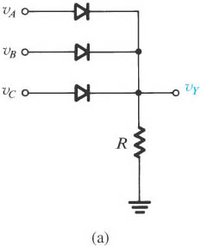
In figure, assume ideal diode model (V_{D}=0V) for the diodes. Calculate all possible output voltages. Input voltage (V_{A}, V_{B}, V_{C} ) values are 5V or 0V.
Figure Diode logic gates: (a) OR gate; (b) AND gate (in a positive-logic system).
Notes:
sedr42021_0305a.jpg

Slide 7
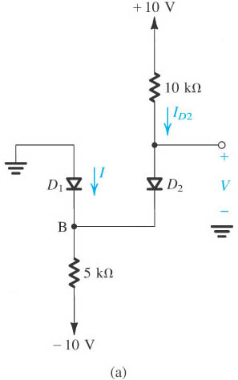
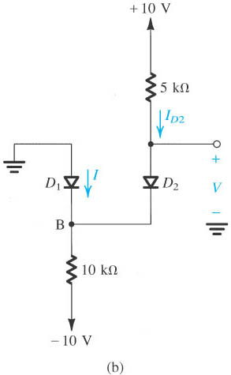


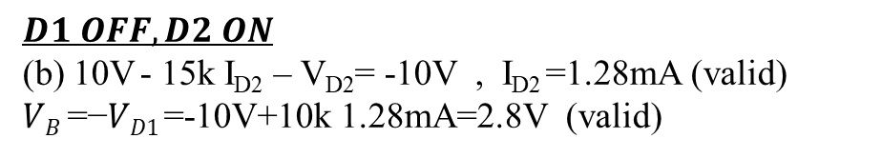
In figure, assume modified ideal diode model (V_{D}=0.7V) for the diodes. Calculate output voltage.
$D1 ON, D2 OFF$
(b) $VD2$= 10V-(-V_{D1})= 10.7V (not valid)
$D1 OFF, D2 OFF$
(b) $VD2$= 10-(-10) = 20V (not valid)
$D1 OFF, D2 ON$
(b) 10V - 15k I_{D2} – V_{D2}= -10V , I_{D2} =1.28mA (valid)
$VB \text{=}\text{−}VD1$=-10V+10k 1.28mA=2.8V (valid)
Notes:
sedr42021_0306a.jpg

Slide 8
All PN diodes shown below have a voltage drop of 0.6V when they are “ON”. Calculate output voltage with the given values (V_{a}=4V, V_{b}=3V).

Slide 9
